Slide 1
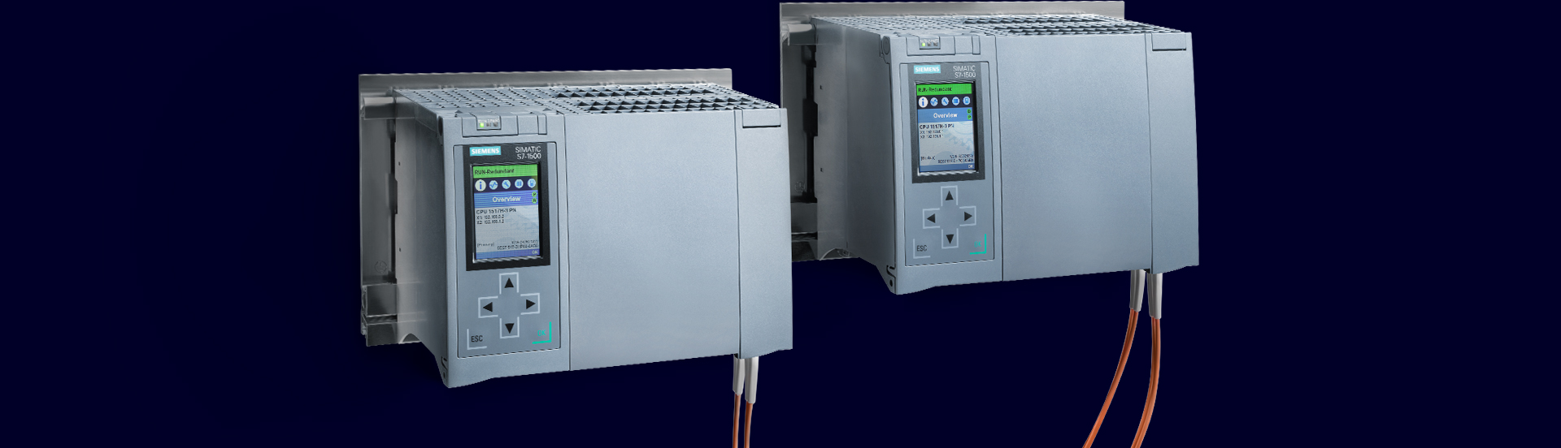
Redundant Systems
SIMATIC S7-1500 R/H
Technical details

Slide 2
SIMATIC S7-1500 Redundant Systems
Further technical slide sets
This document is part of a three-part set of slides
Part 1: Redundant Systems SIMATIC S7-1500 R/H
Part 2: PROFINET System Redundancy with S7-1500 R/H and ET 200
Part 3: Network configuration with S7-1500 R/H
This document
Legend:
New
New with TIA Portal V18 / Firmware V3.0

Slide 3
SIMATIC S7-1500 Redundant Systems
Content
Motivation and product strategy
System Overview
Failure Scenarios
Communication via System IP addresses
Safety for Redundant Systems
Load Program / Project
Hardware extensions in Run with IO-Link
HMI Connection
Programming Recommendations
Specific Functions for R/H
Security for Redundant Controllers
What‘s new with Firmware V3.0
Add-Ons
Feature Comparison / Limitations
Ordering Information

Slide 4
Motivation and product strategy
SIMATIC S7-1500 Redundant Systems

Slide 5





SIMATIC S7-1500 Redundant Systems
Motivation
Avoiding plant downtimes
High availability during operation, avoidance of production downtimes
Prevention of data loss
The data is retained and long recovery times after a failure are eliminated.
Prevention of damage
Avoidance of unplanned production stops, where the product to be processed would be permanently damaged.
Operation without persons on site
Trips for maintenance are easier to plan
Save maintenance effort
Applicative solutions are usually
complicated and difficult to maintain
Redundant Systems reduce costs

Slide 6
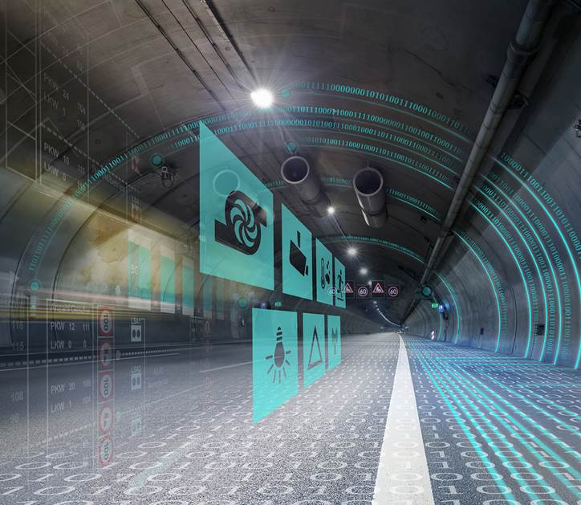
SIMATIC S7-1500 Redundant Systems
Product Strategy SIMATIC S7-1500R/H
Based on standard S7-1500 CPUs and PROFINET
The basis is hardware of the standard and Failsafe CPUs​
The basis is the PROFINET communication standard
Transparent programming (like standard)
Standard engineering tools incl. all programming languages
Complete Integration in TIA Portal​
No special redundancy know-how required
Easy scaling:
Standard CPU → S7-1500 R → S7-1500 H
Standard F-CPU → S7-1500HF ​
Scale extensively
Scaling the switching time (S7-1500 R → S7-1500 H)
Scaling the redundancy architecture
Scaling performance from CPU 1513 to 1518

Slide 7
System Overview
SIMATIC S7-1500 Redundant Systems

Slide 8
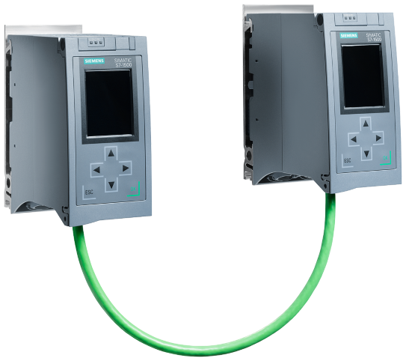
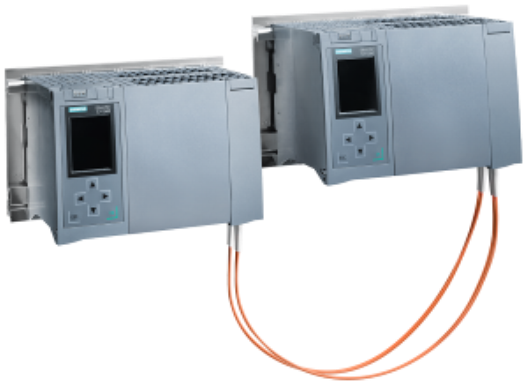
SIMATIC S7-1500 Redundant Systems
System Overview
Consistent concept –
Identical
Synchronization process
Redundant S7-1500R
High Available S7-1500H
CPU Type
CPU 1513R / CPU 1515R
CPU 1517H / CPU 1518HF
Synchronization
via PROFINET Ring (MRP)
via Sync-Module / FO
Hot-Standby
Yes fail-over time ca. 300 ms
Yes fail-over time ca. 50 ms
Max distance between CPUs
100 m, with media converters a few km
40 km
PROFINET System Redundancy
S2 and S1 switched
R1, S2 and S1 switched
Structure of the PROFINET network
MRP Ring
Any

Slide 9
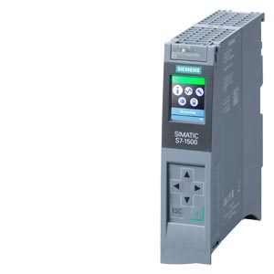
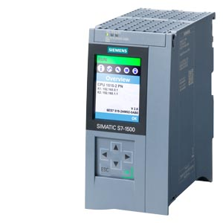
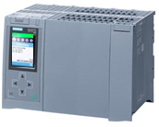
SIMATIC S7-1500 Redundant Systems
CPU Types
New
New
 | CPU 1513R-1 PN 6ES7513-1RM03-0AB0 | CPU 1515R-2 PN 6ES7515-2RN03-0AB0 | CPU 1517H-3 PN 6ES7517-3HP00-0AB0 | CPU 1518HF-4 PN 6ES7518-4JP00-0AB0
Program/ Memory | 600 kB Code 2.5 MB of data | 1 MB Code 4.5 MB of data | 2 MB Code 8 MB data | 9 MB Code 60 MB data
Interfaces
Firmware | From V3.0 | From V3.0 | From V2.6 | From V2.8
SIPLUS variant | - | - | 6AG1517-3HP00-4AB0 | -
X1
X1
X2
X1
X2
X3
X4
X1
X2
X3
X4
X5
Fail-safe
PROFINET IO Controller, Supports RT, MRP, TCP/IP, Open User Communication
PROFINET Basic Services, TCP/IP, Open User Communication
SFP module slot for H-synchronization

Slide 10
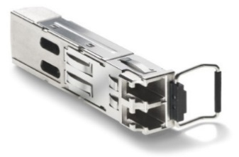
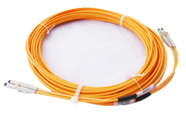
SIMATIC S7-1500 Redundant Systems
Sync modules and sync lines
Sync Module
4 pieces per H-system
Sync Cable
2 pieces per H-system
Distance | Sync Module | Sync Cable | Fiber Type / Connector
Up to 10 m | 6ES7960-1CB00-0AA5 | Pre-fabricated: 6ES7 960-1BB00-5AA5 (1m) 6ES7 960-1BC00-5AA5 (2m) 6ES7 960-1CB00-5AA5 (10m) | Multimode / LC
From 2 m to 10 km | 6ES7960-1FB00-0AA5 | Single mode fiber 9/125 µm Specification OS1 or OS2 | Single Mode/LC
From 8 km to 40 km | 6ES7960-1FE00-0AA5 | Single mode fiber 9/125 µm Specification OS2 | Single Mode/LC
New
Overview of fiber optics at Siemens:
https://mall.industry.siemens.com/mall/en/en/Catalog/Products/10000396?tree=CatalogTree

Slide 11
Failure Scenarios
SIMATIC S7-1500 Redundant Systems

Slide 12






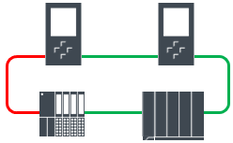
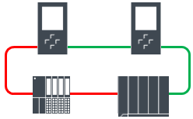
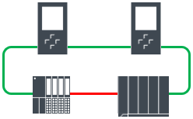


Failure scenarios for S7-1500 R/H
IO connection via Ring topology
Initial state
Primary
Backup
RUN-redundant
RUN-redundant
I/O data
Primary CPU or backup CPU failure
Failure of an IO device
Failure of a PROFINET cable in the ring
IO communication is switched to the remaining CPU
IO communication takes place via MRP ring
from Primary CPU to remaining
IO-Devices
IO communication continues via
MRP Ring.
Primary
Primary
Backup
Primary
Backup
RUN-Solo
RUN-
redundant
RUN-
redundant
RUN-
redundant
RUN-
redundant

Slide 13


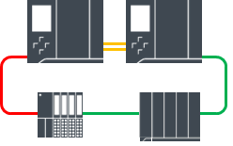
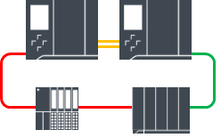
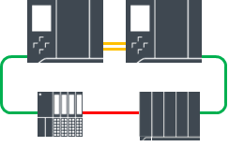
Failure scenarios for S7-1500 H (from firmware V3.0)
IO connection via Line topology
New
Initial state
Primary
Backup
RUN-
redundant
RUN-
redundant
I/O data
Primary CPU or backup CPU failure
Failure of an IO device
Failure of a
PROFINET line
IO communication is switched to the remaining CPU
IO communication takes place via Fiber H-Sync Connection from Primary CPU to remaining
IO-Devices
IO communication takes place directly or via Fiber H-Sync Connection von Primary CPU
Primary
Primary
H-Sync
Backup
Primary
H-Sync
Backup
RUN-Solo
RUN-
redundant
RUN-
redundant
RUN-
redundant
RUN-
redundant

Slide 14
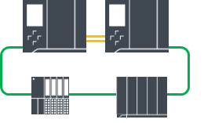
Failure scenarios for S7-1500 R/H
Double fault: Failure of an IO device AND der Primary-CPU
Behavior with S7-1500R
Primary
Backup
Primary
Backup
Primary
RUN-redundant
RUN-redundant
RUN-redundant
RUN-redundant
STOP
IO device fails → System continues
Primary CPU fails → System failure!
Behavior at S7-1500H
Primary
Backup
Primary
H-Sync
Backup
H-Sync
Primary
RUN-redundant
RUN-redundant
RUN-redundant
RUN-redundant
RUN-Solo
IO device fails → System continues
Primary CPU fails → System continues

Slide 15
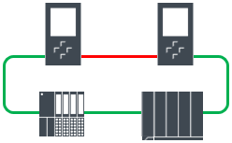
Failure scenarios for S7-1500 R
Failure of redundancy connections to CPU synchronization
Behavior with S7-1500R
Primary
Backup
Primary
Backup
Primary
Backup
RUN-redundant
RUN-redundant
RUN-redundant
RUN-redundant
RUN-Solo
STOP
Direct redundancy connection fails
→ System remains in RUN redundant
Additional: Failure of a Profinet connection in the ring
Case 1: Time interval between the two failures > 100ms
→ Run-solo operation with partial failure of IO devices
Case 2: Time interval between the two failures < 100ms
→ Both CPUs are in the primary role
(undefined state)

Slide 16
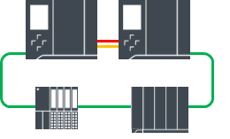
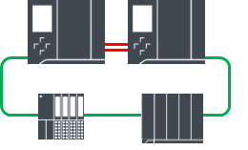
Failure scenarios for S7-1500 H
Failure of redundancy connections to CPU synchronization
Behavior at S7-1500H
Primary
Backup
Primary
H-Sync
Backup
Primary
H-Sync
Backup
RUN-redundant
RUN-redundant
RUN-redundant
RUN-redundant
RUN-Solo
STOP
1 fiber optic redundancy connection fails
→ System remains in RUN redundant
Additional: Failure of the second fiber optic redundancy connection
Case 1: Time interval between the two failures > 55ms
→ Run-Solo operation
Recommendation:
Routing sync lines separately on the H-System
Case 2: Time interval between the two failures < 55ms
→ Both CPUs are in the primary role
(undefined state)

Slide 17

Failure scenarios for S7-1500 H (from firmware V3.0)
Design with system redundancy R1 and MRP rings
New
Initial state
Primary
Backup
RUN-
redundant
RUN-
redundant
I/O data
Network 1
Network 2
Primary CPU or backup CPU failure
Failure of an interface module
Failure of a
PROFINET network
IO communication is switched to the remaining CPU and the second interface module.
IO communication takes place via Fiber H-Sync Connection from Primary CPU to remaining
IO-Devices
IO communication takes place directly or via Fiber H-Sync Connection von Primary CPU
Primary
Primary
Backup
Primary
Backup
Primary
Backup
Primary
Backup
RUN-Solo
RUN-
redundant
H-Sync
RUN-
redundant
RUN-
redundant
H-Sync
RUN-
redundant
Network 1
Network 2
Network 1
Network 2
Network 1
Network 2

Slide 18
Specific failure scenarios for S7-1500 H
Setup with system redundancy R1 – failure of one Pilotages
New
2 MRP Rings
Line topology - with feeding from the same direction
Line topology – with feeding from different directions
Primary
Backup
Primary
Backup
Primary
Backup
RUN-Redundant
RUN-Redundant
RUN-Redundant
RUN-Redundant
RUN-Redundant
RUN-Redundant
After MRP reconfiguration, all IO devices continue to work
IO data is forwarded to the IO devices via the backup CPU
IO data is forwarded via the backup CPU.
All IO devices continue to work

Slide 19
Specific failure scenarios for S7-1500 H
Setup with system redundancy R1 – failure of two Pilotages
New
2 MRP Rings
Line topology - with feeding from the same direction
Line topology – with feeding from different directions
Primary
Backup
Primary
Backup
Primary
Backup
RUN-Redundant
RUN-Redundant
RUN-Redundant
RUN-Redundant
RUN-Redundant
RUN-Redundant
After MRP reconfiguration, all IO devices continue to work
IO devices fail after interruption
IO data is forwarded via the backup CPU.
All IO devices continue to work

Slide 20
Communication via System IP and Device IP addresses
SIMATIC S7-1500 Redundant Systems

Slide 21
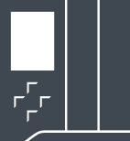

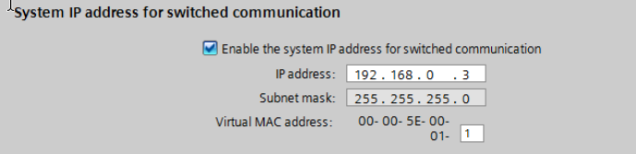





Communication via System IP
IP addresses for the R/H system
In addition to the Device IP addresses, for each interface pair of the R/H system, another
System IP address can be activated.
X2 interface
X2: System-IP1
X2: Device IP11
X2: Device IP12
Primary
Backup
X1 interface
X1: System-IP2
X1: Device IP21
X1: Device IP22

Slide 22
Communication via System IP
Behavior assigned to the primary CPU.
The System IP address is automatically assigned to the primary CPU.
For a communication partner (e.g. standard PLC or HMI), the R/H system behaves like a "normal" (non-redundant) connection partner.
X2: System-IP1
Primary
Backup
X1: System-IP2

Slide 23
Communication via System IP
Behavior with Primary Backup Failover
If the primary controller fails, the System IP addresses are automatically moved to the backup PLC
→ A standard controller / HMI can continue to communicate via the same IP address
X2: System-IP1
Primary
X1: System-IP2

Slide 24
Communication via Device IP addresses
Behavior automatically assigned to the primary CPU.
Communication via Device IP addresses works both via the Primary as well as via the backup CPU.
Please note: Using the connection via the Backup-PLC leads to higher sync load in the system.
Communication via Primary PLC
Communication via the Backup PLC
Receiving data
Data is forwarded
Receiving data
2
3
X2: Device IP 11
X2: Device IP 12
X2: Device IP 11
4
X2: Device IP 12
Data is requested
Data is requested
Primary
SYNC
Backup
Primary
SYNC
Backup
1
3
1
2
5
Synchronizing data
Synchronizing job
Synchronizing data

Slide 25
Safety for
Redundant Systems
SIMATIC S7-1500 Redundant Systems

Slide 26
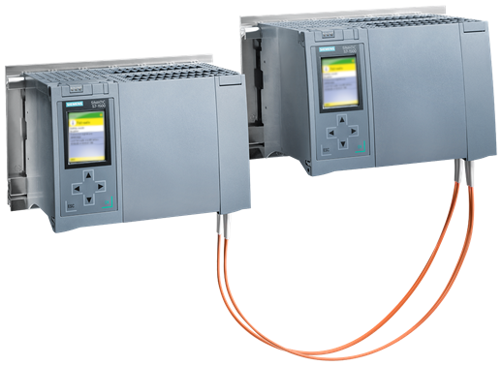

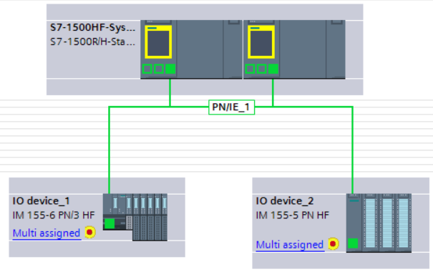
Safety for Redundant Systems
Realize Safety Applications with redundant Controller
High Availability + Failsafe = CPU 1518HF
Engineering ab STEP 7 Professional V17 und STEP 7 Safety
Safety programming as with non-redundant fail-safe PLC
Supported PROFIsafe Communication
Supports flexible F-Link (safe controller/controller communication)
Fail-over scenario without stop the safety program
Almost Commissioning Mode
The Fast Commissioning Mode in deactiviated safety mode allows short turnaround times:
    Faster compile time of the F program
    In this mode, the F program can also be loaded in the System State RUN
  To change back to the safety mode, a STOP-RUN transition is required

Slide 27
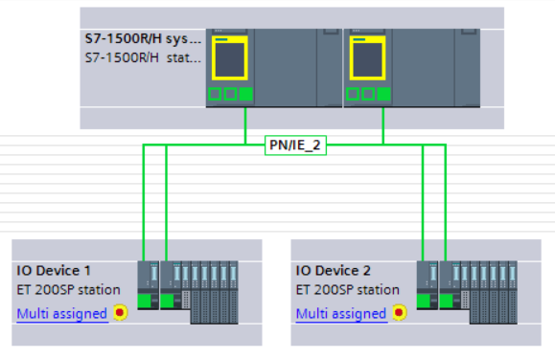
Safety for Redundant Systems
Realize Safety Applications with redundant Controller
High availability + Fail-safe = CPU 1518HF
Both S2 and R1 configurations are supported
New

Slide 28


Network configuration with S7-1500 HF
Safety Devices
Direct integration of fail-safe devices with SIMATIC CPU 1518HF​
Primary
Backup
Safety Application
runs on CPU 1518HF
Direct connection of PROFIsafe IO devices
H-Sync
Safe CPU-CPU communication via
Flexible F-Link

Slide 29

Network configuration with S7-1500 R
Safety Devices
Connection of fail-safe devices via a subordinate F-controller
Primary
Backup
R-System (Non Safety) with connected peripherals
(Not safe) Communication between R and F controllers via iDevice or Open User Communication
Safety Application
runs in a separate
F-Controller

Slide 30
Network configuration with S7-1500 R
Safety Devices
Connection of fail-safe devices by a subordinate F-controller with PN/PN coupler​
Primary
Backup
R-System (Non Safety) with connected peripherals
(Not safe) Communication between R and F controllers via PN/PN couplers
Optional
Media redundancy (MRP ring) increases availability in the event of network interruptions
Optional
Use of a second PN/PN coupler to avoid
„Single Point of Failure“
Safety Application
runs in a separate
F-Controller
MRP Ring

Slide 31
Load project
Load program
SIMATIC S7-1500 Redundant Systems

Slide 32

Load project in S7-1500R/H
Procedure with changes to the hardware configuration
Changes to the hardware configuration can only be loaded in the STOP state of a CPU.
To minimize downtime, the following procedure is recommended:
CPU 1
stop
2
4
CPU 1
start
RUN
(Primary)
STOP
(with old project)
SYNCUP
(New project will be
transferred)
RUN
(Backup)
CPU 1
SYNCUP
Project is
Transfer automatically
CPU 2
RUN
(Backup)
STOP
(with new project)
Startup
RUN
(with new project)
RUN
(Primary)
1
3
Stop CPU 2
and load new project ¹⁾
CPU 2
start
Previous project is active
Down-
Time
New project is active
1) Using the "Load into Backup CPU" function from the project tree of the TIA Portal

Slide 33
Load project in S7-1500R/H
Rollback to previous project status
With a similar approach, a quick "rollback" to the original status of a project planning can also be realized.
This can be useful if a program change is not successful.
CPU 1
stop
2
5
CPU 1
start
RUN
(Primary)
STOP
(with old project)
Run-up
RUN
(With old project)
RUN
(Primary)
CPU 1
SYNCUP
Project is
Transfer automatically
Testing phase
CPU 2
RUN
(Backup)
STOP
(with new project)
Run-up
RUN
(with new project)
STOP
SYNCUP
(Old project is
transferred)
RUN
(Backup)
1
3
4
6
Stop CPU 2
and new project
laden
CPU 2
start
CPU 2
stop
CPU 2
start
Previous project is active
Down-Time
New project
is active
Down-Time
Rollback: Old project is activated

Slide 34
Load program in S7-1500R/H
Procedure without changes to the hardware configuration
If only the program of the CPU has been changed, this can be loaded in the RUN-Redundant state
CPU 1
Load
RUN
(Primary)
RUN
(Primary)
CPU 1
Program will be
automatically synchronized
CPU 2
RUN
(Backup)
RUN
(Backup)
Previous program is active
New program
is active

Slide 35
Hardware extensions in RUN with IO-Link
SIMATIC S7-1500 Redundant Systems

Slide 36
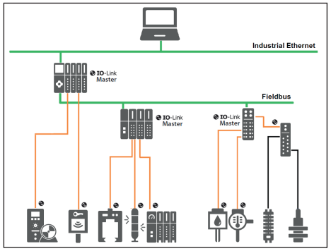

Hardware extensions in RUN with IO-Link
Applications
IO-Link for the extension of the hardware of a plant in the RUN
By using IO-Link, it is possible to carry out plant expansions without interrupting operation.
What is IO-Link?
IO-Link is a standardized point-to-point IO technology (IEC 61131-9)
to communicate digitally with sensors and actuators.
IO-Link devices are offered by most sensor manufacturers
Siemens has IO-Link masters for the complete ET 200 family in its portfolio
  AND 200SP
  AND 200MP
  AND 200eco PN
  AND 200AL
  AND 200pro
The following use cases can be solved with IO-Link
Add new sensors or actuators
Change the type of a sensor / actuator
Configure measuring point (e.g. adjust measuring range)
More information about IO-Link?
See https://www.siemens.com/io-link
or https://io-link.com/

Slide 37





Hardware extensions in RUN with IO-Link
Functionality
With IO-Link, the actuators/sensors are configured directly via the IO-Link master.
The CPU or the RH system is not involved.
Sequence of HW configuration with conventional actuators/sensors
Procedure of the hardware configuration with IO-Link
Primary
Backup
Primary
Backup
1
2
1
CPU data is changed
→currently only possible in STOP state
Data is only changed in the IO-Link devices
→ Also in condition
RUN-Solo / RUN-Redundant
possible
Sensor
Sensor
TIA Portal project is loaded into the PLC
PLC sends the data to the ET 200
S7-PCT Tool loads the data into the IO-Link master
The IO-Link master configures the IO-Link devices

Slide 38
Hardware enhancements in RUN (CiR) with IO-Link
Procedure – Add new measuring point
Construction
Commissioning phase
System im STOP
Hardware Extension
Production phase
System in RUN-Redundant
Program Extension
Production phase
System in RUN-Redundant
Reserve IO-Link master modules into a
Install ET 200 station
Perform TIA HW configuration
Load TIA Portal Project
Connecting the sensor to the IO-Link master
Starting the IO-Link configuration tool "S7-PCT" from the TIA Portal
Inserting and parameterizing IO-Link sensor/actuator in PCT
IO-Link Master laden
→ Process values of the IO-Link device are exchanged
Use a corresponding PLC tag (symbol) in the TIA Portal and in the PLC program
Load the supplemented PLC program into the R/H system
→ The program evaluates the data of the new measuring point
Advantage:
An IO-Link port can universal for all channel types will use:
  Digital input
  Digital output
  IO-Link (Analog Values)
  → Only one assembly type for all applications
    ET 200SP: CM 4xIO-Link, 6ES7137-6BD00-0BA0
    ET 200MP: CM 8xIO-Link, 6ES7547-1JF00-0AB0

Slide 39
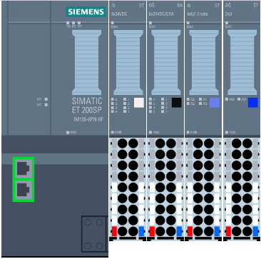
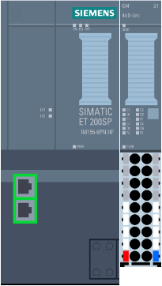
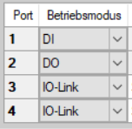

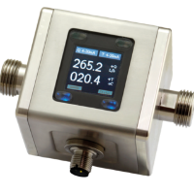


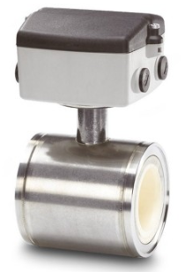
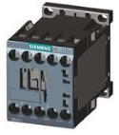
Connection of a sensor / actuator
Example: ET 200SP
Conventional
Four different module types are required
With IO-Link
Only 1 module type is required
DI DQ RTD AI
CM IOL
The connection is selected via S7-PCT
→ In RUN-redundant state
of the R/H system possible
Proximity switch
24 VDC
Proximity switch
24 VDC
Flow
Temp-
Sensor
PT 100
Temp-
Sensor
Contactor
24 VDC
Flow
4..20mA
Contactor
24 VDC

Slide 40
HMI Connection
SIMATIC S7-1500 Redundant Systems

Slide 41






HMI Connection via a non-redundant network using System IP address
An HMI connection via the System IP addresses for a non-redundant network is possible in all cases.
WinCC
Panel
Note when connected via X2:
If the connection to the Primary PLC is interrupted, communication with the R/H system is no longer possible because the System IP address remains with the Primary PLC. In this case, the role of the PLCs can be changed programmatically to remedy the situation. See slide RH_CTRL Instruction
System IP (X2)
X2
X2
System IP (X1)
X1
X1
Communication
interrupted
Communication
OK
Role exchange
System-IP
System-IP
Primary
Backup
Backup
Primary

Slide 42
HMI Connection via a non-redundant network using Device IP addresses
An HMI connection via the Device IP addresses requires a switching option on the HMI side. This is possible with
WinCC OA ab V3.18
WinCC V7.5 SP1 via Scripting
SIMATIC Panels via Scripting
The following application example is available for connecting SIMATIC panels to an R/H system:
https://support.industry.siemens.com/cs/ww/de/view/109781687
WinCC
Panel
X2: IP1
X2: IP 2
X1: IP3
X1: IP4

Slide 43
HMI Connection via redundant network using Device IP addresses
The HMI connection via a redundant network using Device IP addresses is possible with
WinCC OA ab V3.18
WinCC V7.5 SP1 via Scripting
The communication connection is switched by WinCC in the event of a fault. See
https://support.industry.siemens.com/cs/ww/de/view/109773067
WinCC
WinCC
X2: IP1
X2: IP 2

Slide 44
HMI Connection via redundant network using System IP addresses
The HMI connection via a redundant network using System IP addresses is possible with
WinCC OA ab V3.18
WinCC V7.5 SP1 via Scripting
Use of R/H interfaces:
System IP of X1 and X2 for CPU 1515R-2 PN and CPU 1517H-3 PN
System IP of X2 and X3 with CPU 1518HF-4 PN
Behavior in case of error:
If the primary CPU fails, the RH system switches over by moving the System IP addresses
If a network fails, WinCC switches over
WinCC
X2: System IP
X3: System IP
X2
X3
X2
X3

Slide 45
Programming Recommendations
SIMATIC S7-1500 Redundant Systems

Slide 46
Programming recommendations SIMATIC S7-1500 R/H (I)
1) Set maximum cycle time
The maximum cycle time should be set as large as the process allows.
This can shorten the time for the SYNCUP, as the transition to RUN-redundant only takes place when the actual cycle time is <80% of the set maximum cycle time.
Recommendation:
2) Set minimum cycle time as high as possible
By increasing the minimum cycle time to the minimum value required for the process, the system load due to synchronization is reduced.
This also shortens the SYNCUP phase and leads to higher performance in communication.
0ms
Max cycle time parameter
Maximum cycle time of the program
Dead time when switching
300ms with R-CPU
50ms for H-CPU
Reserve
60%
40%

Slide 47

Programming recommendations SIMATIC S7-1500 R/H (II)
3) Avoid direct peripheral access
Each direct peripheral access is synchronized in the system state RUN-Redundant and leads to a higher cycle time.
Recommendation: In the RH system, the inputs and outputs of the IO devices should only be accessed via the process image or the subprocess images.
4) Reduce communication during the SYNCUP phase
If possible, the communication load should be kept low during a SYNCUP phase. This will speed up the SYNCUP process. This can be done programmatically via the SFC "GET_DIAG".
5) Reduce cyclic interrupts during the SYNCUP phase
If cyclic interrupts are used intensively in the program and it is tolerable to reduce the call frequency during the SYNCUP phase, then the sync load can be reduced by calling the system function "SFC SET_CINT". This measure also helps to shorten the SYNCUP time. In normal state (RUN-Solo or RUN-Redundant) the alarm times can then be changed back to the original state.

Slide 48

Programming recommendations SIMATIC S7-1500 R/H (III)
6) Use of the WAIT function in the system state SYNCUP
If a longer cycle time is tolerable in the SYNCUP system state, the SYNCUP process can be accelerated by calling the system function "WAIT" at the end of OB1. This is possible because the WAIT function on the backup PLC is used to catch up.
Primary PLC
Cycle time of the program in the
Normal
Programmed latency
in SYNCUP state
Backup PLC
Cycle time of the program in the
Normal
Backup PLC uses the time to catch up in SYNCUP
Cycle time of the program in the system state SYNCUP

Slide 49
Specific functions for R/H controllers
SIMATIC S7-1500 Redundant Systems

Slide 50
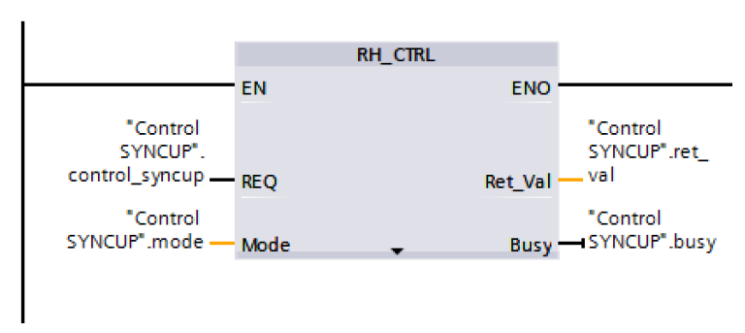



RH_CTRL Instruction
Switch CPU programmatically
Extensions of the RH_CTRL instruction
Request SYNCUP: If the system is in the RUN-Solo state, the SYNCUP can be restarted by calling this function to bring the system back into the redundant state.
Stop Primary-PLC: When running redundantly, the primary PLC is stopped and the backup PLC runs in RUN solo mode.
If the SYNCUP is then requested again (mode 7), the system works with swapped roles (primary/backup) redundant.
Stop backup PLC: When running redundantly, the backup PLC is stopped and the primary PLC continues to run in RUN solo mode.
Mode | Function
3 | Lock SYNCUP
4 | Share SYNCUP
7 | Request SYNCUP
8 | Stop Primary-PLC
9 | Stop Backup PLC
10 | Check if SYNCUP is locked
Primary
Backup
STOP
Primary
Backup
Primary
RH_CTRL
Mode 8
RH_CTRL
Mode 7
RUN-Redundant
RUN-Solo
RUN-Redundant
New

Slide 51



Switched S1
Adjustable switching time for the "Switched S1" function
Switching process for S1 devices
1
2
3
4
5
Primary
Backup
Primary
Primary
Primary
Primary
X
X
X
X
Single AR
Single AR
Single AR
Single AR
S1
S1
X
S1
X
S1
X
S1
Operation
Connection in the device
still available
Connection
degraded
New connection
Device not yet active
Device Startup
completed
System in redundant operation, IO data is exchanged
After fail-over: IO Device holds the existing connection until the expiration of the Watchdog-Time.
As long as no further connection is possible.
IO device is ready for a new connection to the controller
The new connection is established, the IO device start-up begins
IO data is exchanged again
AR = Application Relation (connection between controller and device)

Slide 52
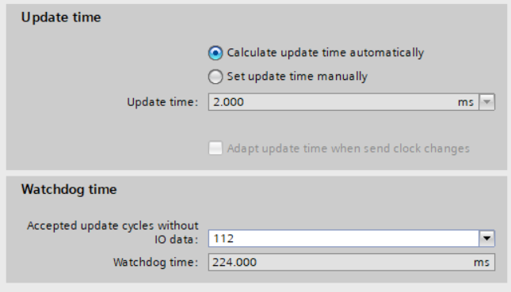
Switched S1
Adjustable switching time for the "Switched S1" function
Previous time behavior (with FW version 2.8)
Waiting time before switching
(Not adjustable)
Activation of the new AR
IO-Device specific start-up time
New time behavior (with FW version 2.9)
Watchdog-Time
(individually adjustable for each device)
Activation of the new AR
(Optimized)
IO-Device specific start-up time
Example measurement with CPU 1517H and iDevice (short device start-up time)
 | FW V2.8 | FW V2.9
IO data active again after | 3 seconds | 0.6 seconds
AR = Application Relation (connection between controller and device)

Slide 53
Reporting loss of redundancy
OB72 reports loss of redundancy during synchronization
If a sync line fails, the maintenance LED on the controller lights up and the H-System continues to work in redundant mode.
The failure of a sync line is reported from firmware V2.9 by calling the OB72 (redundancy loss).
This can be used to report a request to restore the sync line.
Redundancy loss on
H-Sync 2!
Primary
Backup
OB72
H-Sync 1
H-Sync 2
Process underway

Slide 54
Reporting of peripheral redundancy errors
OB70 reports loss of peripheral redundancy
New
In the H system ¹⁾, the OB 70 is called if in the system state RUN-Redundant on a R1/S2 device redundancy loss or a redundancy return event.
Redundancy Loss: An AR of two ARs of an R1/S2 device fails
Redundancy Return: The second AR of an R1/S2 device is rebuilt
Example scenarios for the OB 70 call:
OB 70
OB 70
OB 70
OB 70
H-Sync
H-Sync
OB 86
OB 70
RUN-
redundant
H-Sync
H-Sync
RUN-
redundant
RUN-
redundant
RUN-
redundant
Network 1
Network 2
Network 1
Network 2
Two ARs fail
An AR fails
An AR fails
An AR fails
1) (CPU 1517H / CPU 1518HF with firmware V3.0)

Slide 55
Security at R/H
SIMATIC S7-1500 Redundant Systems

Slide 56



Security Enhancements
Protection of configuration data / Secure communication to HMI and TIA Portal
Extensions from firmware V2.9 and
ab TIA Portal V17
WinCC
TIA Portal V17
1
Protection of configuration data
Secure communication between controllers and TIA Portal V17
Secure communication between controllers and HMI
2
3
2
1
3
3

Slide 57
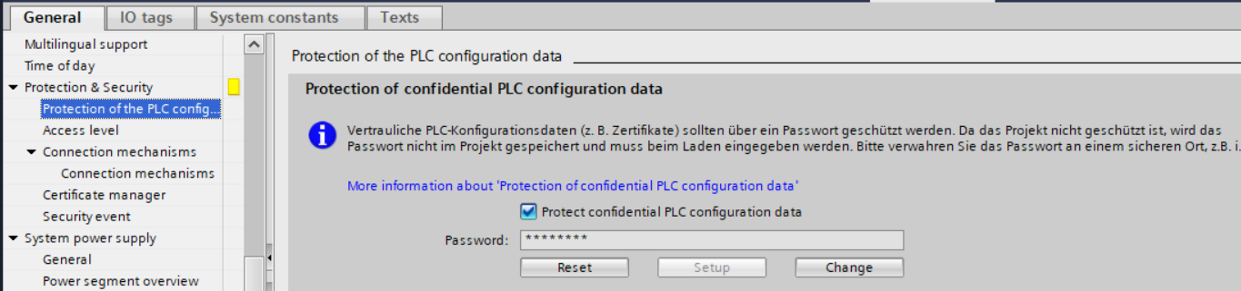
Protection of configuration data
Properties
Configuration data protection can be activated/deactivated via the TIA Portal.
The protection password is not stored in the project but stored independently of the project data in the CPU. It is not readable and must therefore be stored in a safe place.
If protection of the configuration data is activated, special features must therefore be taken into account during the initial commissioning and replacement of a controller. → see next slides

Slide 58





Special features when activating password protection of the configuration data
Initial commissioning of an RH system
Step 1) Load the configuration and set the password
Step 2) Set password in CPU 2
Step 3) Start RH System → Synchronizing data
Alternative 1:
TIA Portal
Alternative 2:
Special password
Memory Card
TIA Portal
TIA Portal
1x
1x
First Download
Start RH System
SYNCUP
CPU 1
CPU 2
CPU 1
CPU 2
CPU 1
CPU 2
Without this step, the SYNCUP process will fail!
Certificate with private key for PG/HMI communication
Password to protect configuration data

Slide 59
Special features when activating password protection of the configuration data
Replacing an R/H CPU
Event: A CPU fails and needs to be replaced
Step 1) Change CPU and reset password
3) Start the new CPU → Synchronizing data
Alternative 1:
TIA Portal / SAT
Alternative 2:
Special password
Memory Card
TIA Portal / SAT
1x
Start CPU
SYNCUP
CPU 1
Defective CPU 2
CPU 1
New CPU 2
CPU 1
New CPU 2
Without this step, the SYNCUP process will fail!
Certificate with private key for PG/HMI communication
Password to protect configuration data

Slide 60
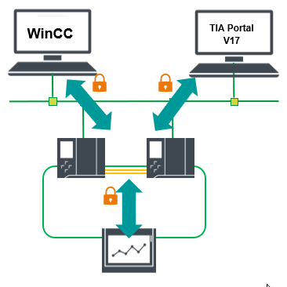
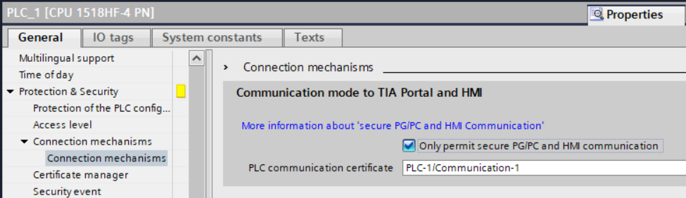
Secure communication with HMI and TIA Portal
For controllers with firmware V2.9 or higher, secure communication
used with
TIA Portal from V17
WinCC Runtime from V17
Basic Panels 2nd Generation, Comfort Panel 1st Generation, Mobile Panels
WinCC Unified ab V17, Unified Comfort Panels
WinCC OA ab V3.18 Patch 4
WinCC ab V7.5 SP2 Update 4
In order to be able to communicate with other HMI devices,
deselect the option shown below.

Slide 61
What's New with Firmware V3.0
(TIA Portal V18)
SIMATIC S7-1500 Redundant Systems

Slide 62
SIMATIC S7-1500 Redundant Systems
What's New with Firmware Version 3.0
New Features / Improvements
System redundancy R1 for S7-1500H and ET 200SP
Flexible network topologies with S7-1500H
Maximum distance between H-CPUs now possible up to 40 km
Support in STEP 7 CFC (TIA Portal V18)
New OB 70 "Peripheral Redundancy Error"
Extensions RH_CTRL SYNCUP Status
New support for SIMATIC S7-1500 standard functions
CREATE_DB, DELETE_CB,
READ_DBL and WRIT_DBL
ReadFromArrayDBL and WriteToArrayDBL

Slide 63



SIMATIC S7-1500H
System redundancy R1 for S7-1500H and ET 200SP
S7-1500H
System Redundancy R1
Increased availability
Seamless switching in the event of an ET 200 SP interface module failure (as well as ET200 SP HA or ET 200 iSP)
High robustness due to two networks (ring or line)
Fault tolerance: CPU, PROFINET Interruption, Interface-Module and Subnet
AND 200SP
Network #1
Network #2
For details on system redundancy R1, see Slide Set – Part 2
„PROFINET System Redundancy with S7-1500R/H and ET 200"

Slide 64
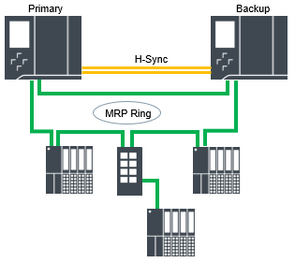
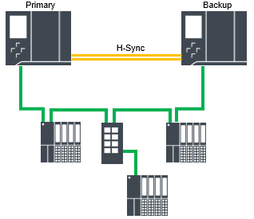
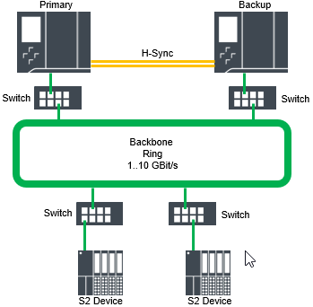
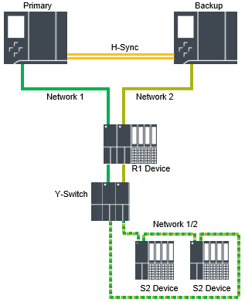
SIMATIC S7-1500H
More flexibility in network structures
In addition to the construction of an MRP ring, any other structures are possible. For example
Line Topology
Separated Ring
Hybrid Topology
Simple MRP ring (since V15.1)
Line Topology
Separated Ring
R1 Line + Y-Switch
Easier to integrate into existing network structures
High flexibility in assembly

Slide 65
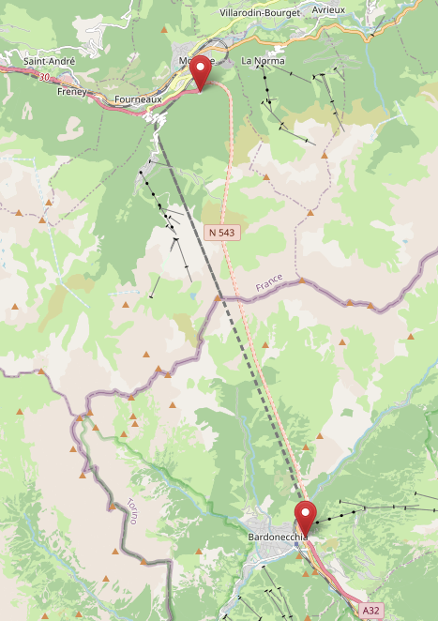
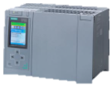
SIMATIC S7-1500H
Wide range fiber optic modules up to 40km
New sync modules for CPU 1517H and CPU 1518HF
Distance between H-CPUs: Minimum 8 km – Maximum 40 km
Application for large-scale structures (tunnel systems)
Requires TIA Portal V18 and CPU firmware V3.0
 | Article | Fiber Optic Type | Length of fiber optic cable
 | 6ES7960-1CB00-0AA5 | Multimode | 10m
 | 6ES7960-1FB00-0AA5 | Single Mode | 2 meters to 10km
 | 6ES7960-1FE00-0AA5 | Single Mode | 8 km to 40km
New
Attention: When using the 40km sync module
6ES7960-1FE00-0AA5 a maximum ambient temperature of 55°C applies

Slide 66


Innovated Hardware for R CPUs
Technical comparison
 | CPU 1513R-1 PN |  | CPU 1515R-2 PN
Article | 6ES7 513-1RL00-0AB0 | 6ES7 513-1RM03-0AB0 | 6ES7 515-2RM00-0AB0 | 6ES7 515-2RN03-0AB0
Installable firmware | Up to V2.9 | From V3.0 | Up to V2.9 | From V3.0
Firmware compatible with | V2.6, V2.8, V2.9 | V2.6, V2.8, V2.9, V3.0 | V2.6, V2.8, V2.9 | V2.6, V2.8, V2.9, V3.0
Display | Part of the front flap | Part of the CPU | Part of the front flap | Part of the CPU
Program memory | 300 kByte | 600 kByte | 500 kByte | 1 Mbyte
Memory | 1.5 Mbyte | 2.5 Mbyte | 3 Mbyte | 4.5 Mbyte
Processing time for bit operations | 80 ns | 50 ns | 60 ns | 20 ns
Operating temperature range | 0°C... 60°C | -30°C... 60°C | 0°C... 60°C | -30°C... 60°C
New
New

Slide 67
Innovated Hardware for R CPUs
Compatibility
The new R-CPUs are spare parts compatible with the existing R-CPUs
Memory cards from existing CPUs can continue to be used 1:1 in the new CPUs
New R CPUs can also be loaded with older TIA Portal versions. Configure the latest FW version there
Attention:
In an R/H system, both CPUs must have the same article number and firmware version
→ If an R CPU fails, the same type must be replaced

Slide 68
Supplements
SIMATIC S7-1500 Redundant Systems

Slide 69
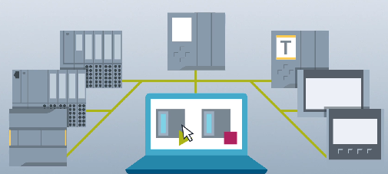
Support of S7-1500 R/H in the SIMATIC Automation Tool (SAT)
As of version 4.0 SP3 of the SIMATIC Automation Tool, redundant controllers (S7-1500 R and S7-1500 H) are also supported.
This can be used, for example, firmware updates or
Program updates can be carried out easily.
Information and download under the following link:
https://support.industry.siemens.com/cs/ww/en/view/98161300
Primary
Backup
SIMATIC Automation Tool

Slide 70
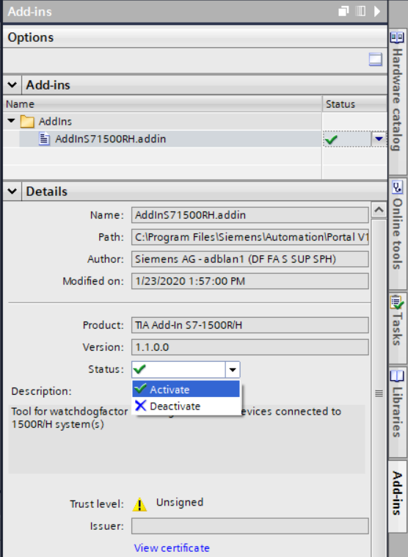
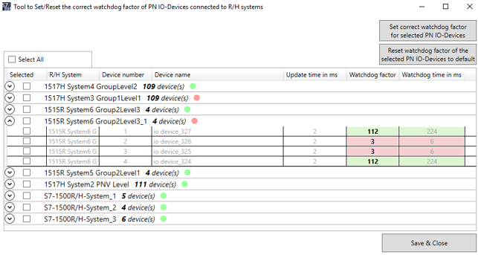
TIA Portal Add-In
Calculation of the watchdog time over a AddIn
To connect a PROFINET device to a redundant S7-1500 R/H system, it is necessary to set the correct watchdog time for each device. The SIMATIC S7-1500 R/H AddIn determines the correct factor and updates it in the settings
Available at https://support.industry.siemens.com/cs/ww/en/view/109769093

Slide 71
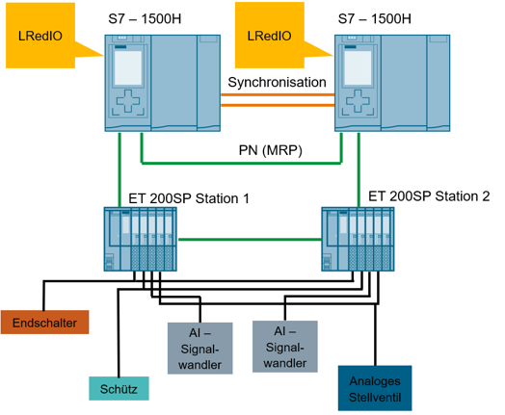
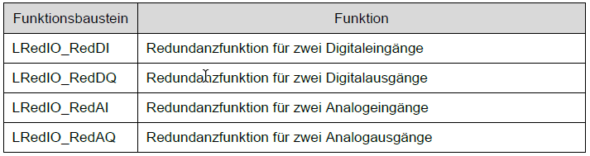
Application Example
Connection of redundant I/O in the user program
In this application example, a possibility is shown how I/O can be redundantly connected to a SIMATIC S7-1500 controller with blocks of the TIA Portal.
Download: https://support.industry.siemens.com/cs/ww/en/view/109767576

Slide 72
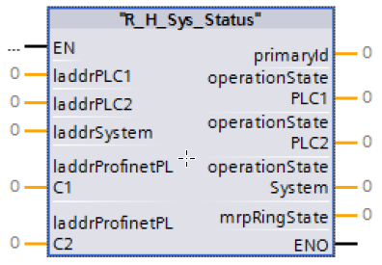
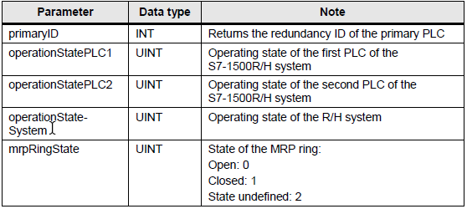
Application Example
Diagnosis of the operating status of a SIMATIC S7-1500 R/H system using FB
A function block is available for download for extended diagnostics of the SIMATIC S7-1500 R/H system.
Advantages
Prefabricated diagnostic block for SIMATIC S7-1500 R/H systems
Simple connection of different hardware addresses for extensive diagnostics
Integrated self-diagnosis function (in addition to the standard diagnostic functions) of the SIMATIC S7-1500 R/H system for early detection and reporting of faults before they affect the process
Download: https://support.industry.siemens.com/cs/ww/en/view/109763768

Slide 73
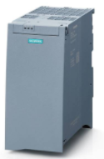
Communication Functions
Telecontrol and substation control technology with SIMATIC S7-1500R/H
Component | Version | Protocols | SIOS
TIM 1531 IRC | From V2.1 | SINAUT ST7 DNP3 IEC 60870-5 101, 104 | https://support.industry.siemens.com/cs/ww/en/view/109774204
SIPLUS RIC Library for SIMATIC S7-1500 | From V1.7 | IEC 60870-5 101,102,103, 104 | https://support.industry.siemens.com/cs/ww/en/view/109422039
IEC 61850 MMS Client AS LIBRARY |  | IEC 61850 MMS | https://support.industry.siemens.com/cs/ww/en/pv/9LA1110-6PC10-2BC8/pi?dl=en

Slide 74
Communication Functions
Redundant communication
Component | Version | Protocols | SIOS | Hint
SIMATIC Modbus/TCP Red S7-1200/S7-1500 |  | Modbus/TCP | https://support.industry.siemens.com/cs/bd/en/ps/6AV6676-6MB40-0AX0
Redundante Open User Communication |  | Various | https://support.industry.siemens.com/cs/ww/en/view/109763719

Slide 75


Redundant power supply
SITOP Redundancy Module RED1200
Redundant design in the event of power failure
  Stable DC voltage due to redundant switching of two
  same power supplies
Redundant design in the event of a power failure
  Feeding of power supplies from different supplies
Flexible use
  Redundant power supply setup for
  DC voltages from 12 to 48 V
Details
Manual

Slide 76
Feature Comparison / Limitations
SIMATIC S7-1500 Redundant Systems

Slide 77
Functional comparison with S7-1500 and S7-400H
 | S7-1500 R/H | S7-1500 | S7-400H
Communications | Open User Communication; S7 communication as server | (Secure) Open User Communication; S7 communication; Configured connections | Open device communication; S7 communication; Configured connections
OPC UA / Webserver | No | Yes | No
Redundant communication | Via LComRed Library | No | Yes
System-IP address | Yes | Not required | No
Redundant I/Os | Via LRedIO Library | Via LRedIO Library | Yes
Technology Objects | Counting, measuring, PID, BasicPos | Yes | No
IRT, Isochrone Mode, MRPD | No | Yes | No
Hardware enhancements in RUN | With IO-Link See slide section | With IO-Link | With switching (H-CiR)
Firmware Update in RUN | No | No | Yes
DHCP with DNS | No | Yes | No

Slide 78
Configuration Restrictions for S7-1500R/H
 | S7-1500 R/H | S7-1500 | S7-400H
Central connection of Modules IO, CM/CP, System Power Supply | No | Yes | Yes
PROFINET network structure | S7-1500H: any S7-1500R: MRP Ring | any | any
Operation of the RH system as Shared Device or iDevice | No | Yes | No
Operation of PROFIBUS devices | Via Coupling-PLC | Yes | Yes
New

Slide 79
Ordering Information
SIMATIC S7-1500 Redundant Systems

Slide 80
Ordering Information
SIMATIC CPU S7-1500 R
  CPU 1513R-1 PN 6ES7 513-1RL00-0AB0
                6ES7 513-1RM03-0AB0 (V3.0)
  CPU 1515R-2 PN 6ES7 515-2RM00-0AB0
  6ES7 513-1RM03-0AB0 (V3.0)
SIMATIC CPU S7-1500 H
  CPU 1517H-3 PN 6ES7 517-3HP00-0AB0
  CPU 1518HF-4 PN 6ES7 518-4JP00-0AB0
At distances of up to 10m between SIMATIC S7-1500 H controllers: Use of synchronization modules for fiber optic cables up to 10 m
  MLFB Module: 6ES7 960-1CB00-0AA5
  MLFB Fiber Optic Cable 1m: 6ES7 960-1BB00-5AA5
  MLFB fiber optic cable 2m: 6ES7 960-1BC00-5AA5
  MLFB Fiber Optic Cable 10m: 6ES7 960-1CB00-5AA5
At distances of up to 10 / 40 km between
SIMATIC S7-1500 H controllers:
  MLFB Module: 6ES7 960-1FB00-0AA5 (10km)
  6ES7 960-1FE00-0AA5 (40km)
  Single mode Fiber optic cable LC/LC duplex crossed 9/125μ
SIMATIC S7-1500 H Bundle
(2 SIMATIC CPU 1517-3 PN, 4 sync modules up to 10m and 2 sync cables 1m)
  6ES7500-0HP00-0AB0
SIMATIC S7-1500 HF Bundle
(2 SIMATIC CPU 1518-4 PN, 4 sync modules up to 10m and 2 sync cables 1m)
  6ES7 500-0JP00-0AB0
New
New
New

Slide 81
Disclaimer
© Siemens 2022
Subject to changes and errors. The information given in this document only contains general descriptions and/or performance features which may not always specifically reflect those described, or which may undergo modification in the course of further development of the products. The requested performance features are binding only when they are expressly agreed upon in the concluded contract.
All product designations may be trademarks or other rights of
Siemens AG, its affiliated companies or other companies whose use by third parties for their own purposes could violate the rights of the respective owner.

Slide 82
Contact
Publisher: Siemens 2022

